Slide 1
Overview of Fiji
Jin Wen Lin

Slide 2
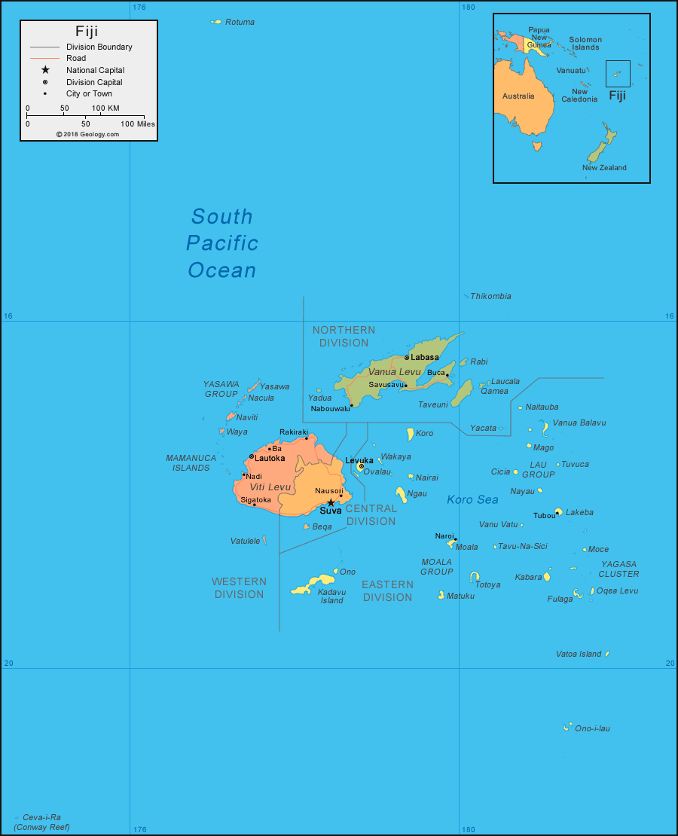
Introduction
Location of Fiji: Oceania, the South Pacific Ocean
About two-thirds of the way between Hawaii and New Zealand
Made up of over 332 islands
110 permanently inhabited
Neighbours of Fiji:
Vanuatu
Samoa
Tonga

Slide 3

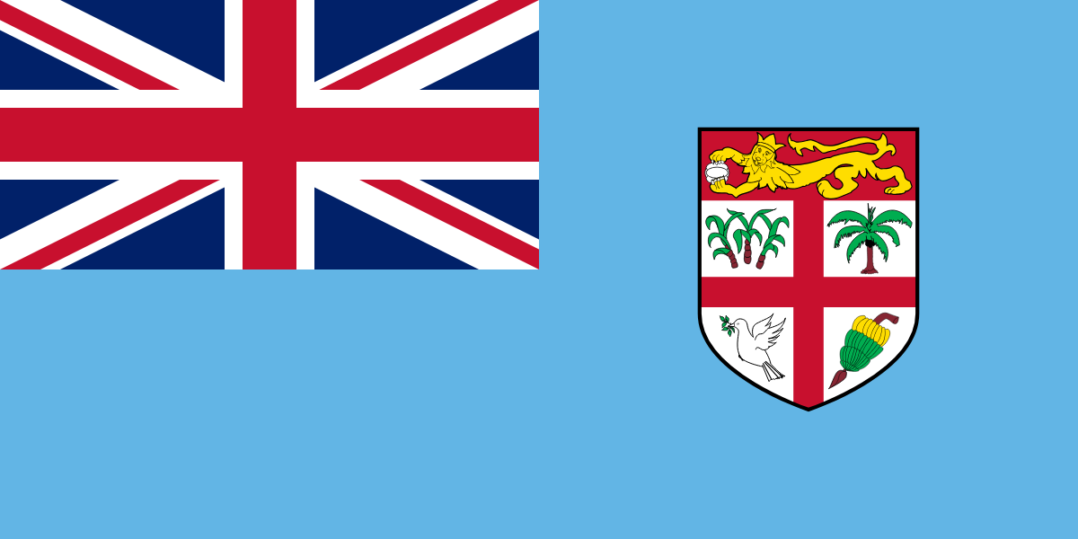
Key Facts: Fiji Government
Republic with a president as the Chief of State and a prime minister as the Head of the Government
President: Ratu Wiliame Katonivere
Prime Minister: Sitiveni Ligamamada Rabuka
Political System: parliamentary democracy
Election Cycle: 3 years
Highest level of judicial authority:
federal supreme court
judges work independently and follow the law in order to make decisions

Slide 4
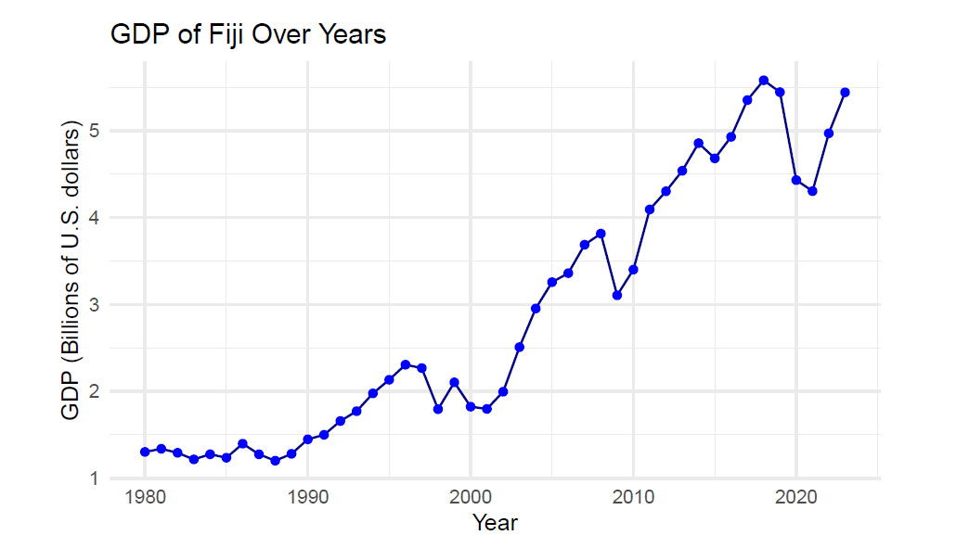
Key Facts: Fiji Economy
One of the most developed countries in the Pacific region.
Top industries : of Fiji
Tourism; sugar; clothing; copra (where coconut oil is extracted)
Largest Trading Partners:
Australia; United States; New Zealand
Fiji exports:
beverages; oil and mineral fuels; seafood
Trend of GDP:
Increases gradually before 2000
Rise more sharp after 2000
Fluctuation included (e.g. Covid-19 in 2019 to 2020)

Slide 5
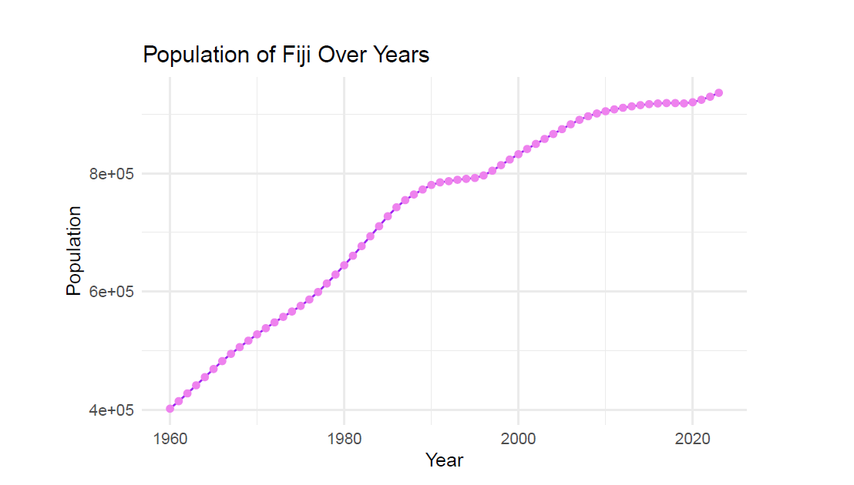
Key Facts: Fiji Population
Population in 2024 is approximately 928,784.
Median age: 27.9
Trend of Population:
steady increase over the years
Population in 2020: over 800,000
Population in 1960: around 400,000

Slide 6
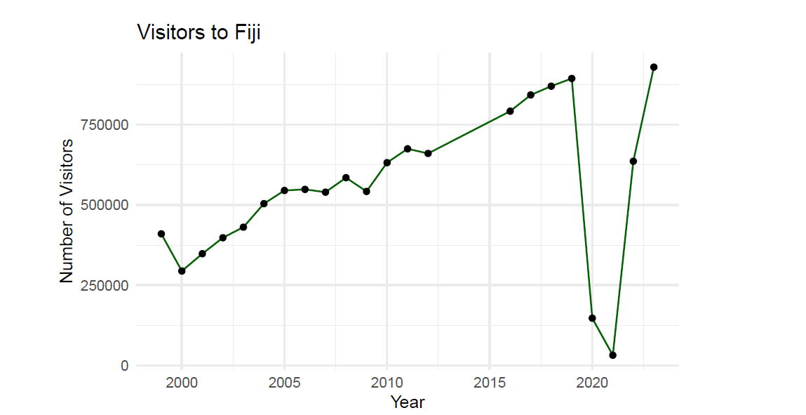
Key Facts: Fiji Tourism
A popular tourist destination known for its beautiful beaches, tropical climate, and clean waters.
Trend of Tourism:
Increasing from 2000 to 2019
Sharp decrease in 2019 to 2021 (Covid-19)
Number of visitors recovers quickly after 2021

Slide 7
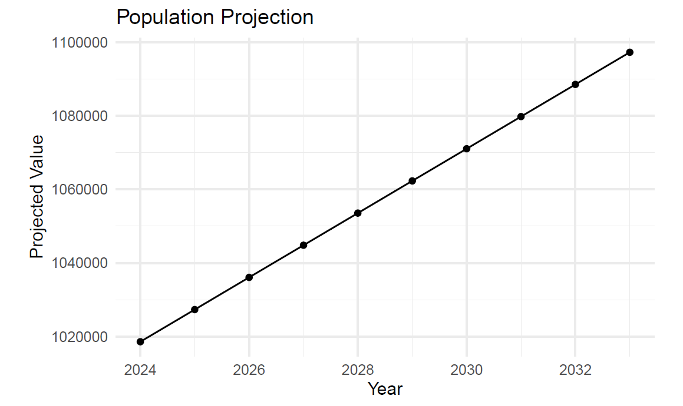
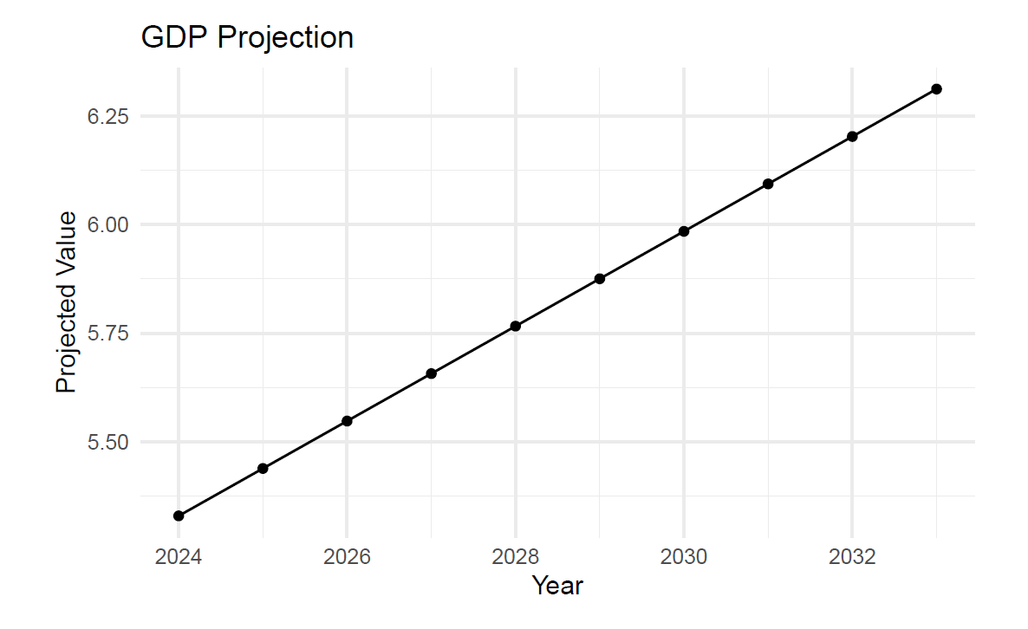
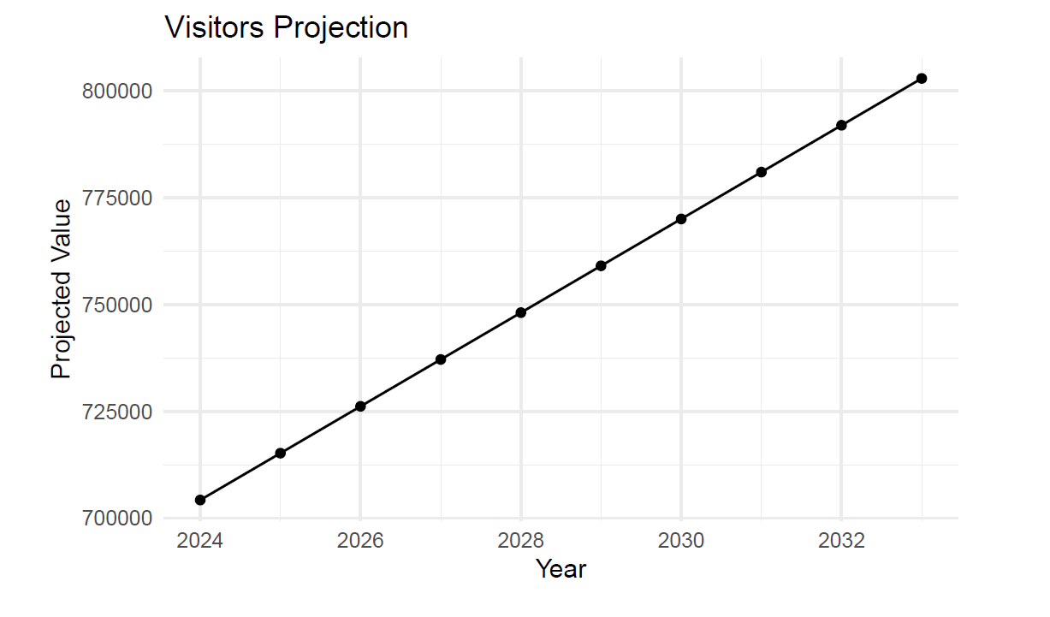
Projections of Population, GDP, and Visitors in the Next 10 Years

Slide 8
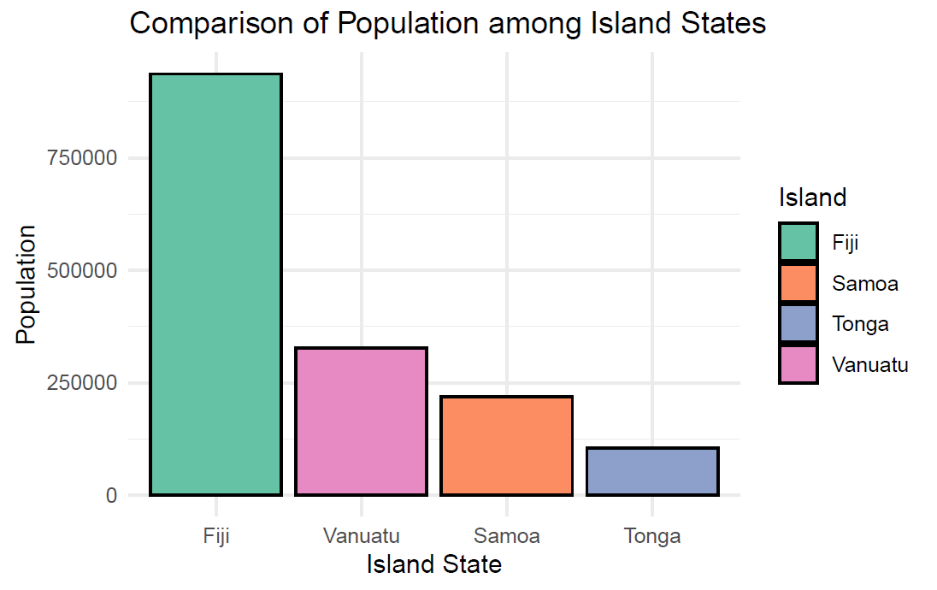
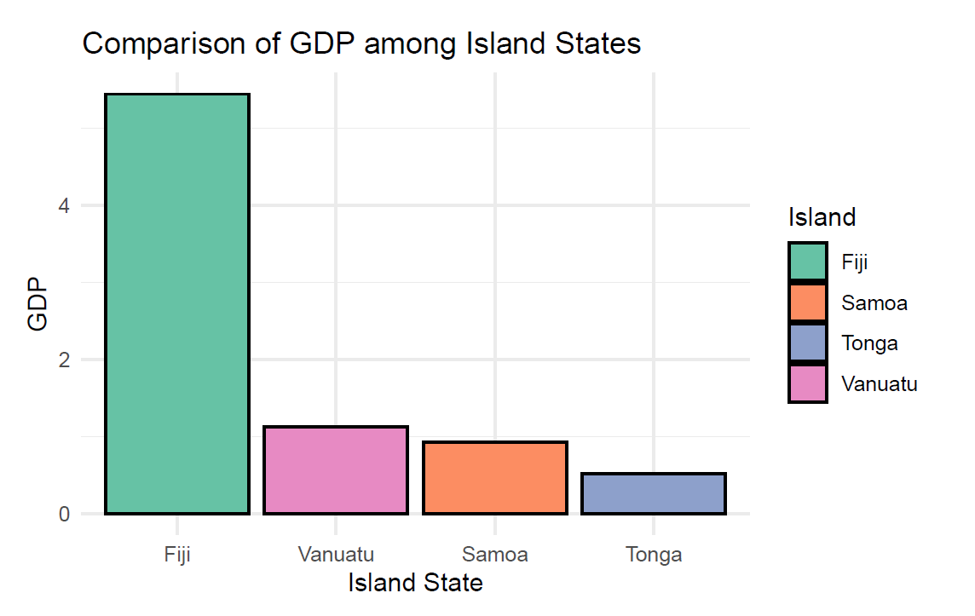
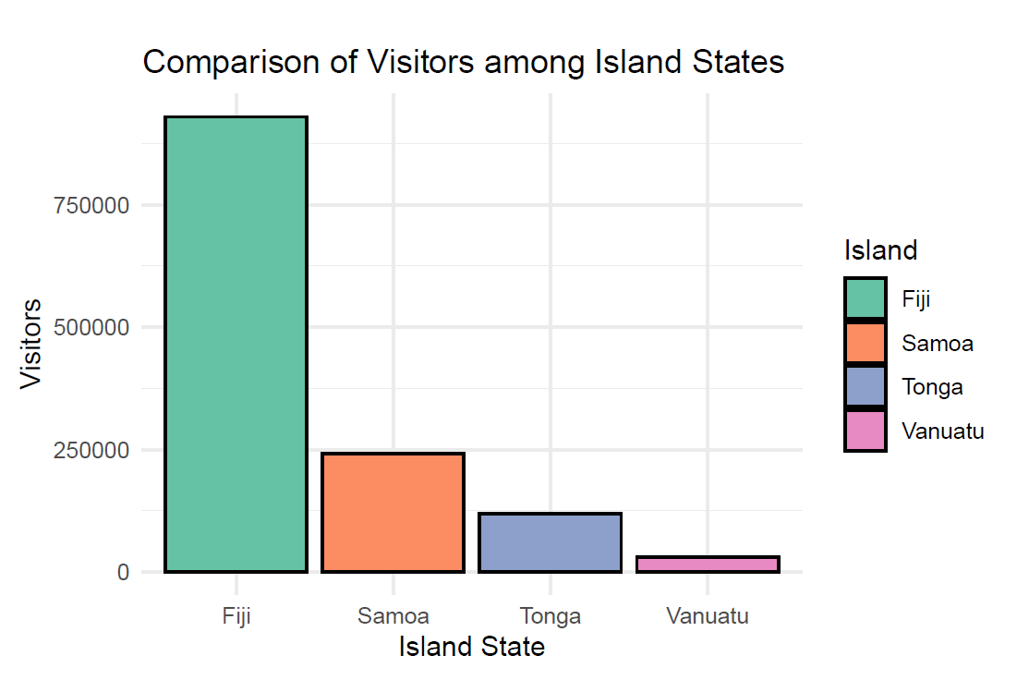
Comparison of Fiji VS Vanuatu, Samoa, Tonga
Fiji takes the lead in Population, GDP, and Tourism!
Vanuatu and Samoa have close population and GDP
Vanuatu has the lowest visitors compared to other islands

Slide 9
References of the Pictures
Second Slide:
https://geology.com/world/fiji-satellite-image.shtml
Third Slide:
https://en.wikipedia.org/wiki/Coat_of_arms_of_Fiji
https://commons.wikimedia.org/wiki/File:Flag_of_Fiji.svg

